Slide 1
Predictive Modelling
Final Project: Telco Customer Churn
Presented By Alamelu Ramanathan

Slide 2
Problem Statement
Telecommunication companies face significant financial losses when customers discontinue their service (churn). It is crucial for telecom companies to predict customer churn early to implement strategies for customer retention and improve business performance.

Slide 3
Key Objectives
Predict Customer Churn: Develop a machine learning model to predict which customers are likely to churn based on historical data.
Understand Key Drivers: Identify the key factors (features) that are most indicative of churn (e.g., subscribed services, payment history, contract type).
Actionable Insights: Provide recommendations for strategies that the company could implement to retain customers likely to churn.

Slide 4
Exploratory Data Analysis
#2. Exploratory data analysis
#understand the dataset
print(ds.info())
print('\n Data dimension', ds.shape)
#check for the missing information
print('\n', ds.isna().sum())
#check availability of data in total charges column
missingTotalCharge = ds.loc[ds['TotalCharges']== " "]
print(missingTotalCharge.shape)
print(missingTotalCharge[["tenure", "Contract", "TotalCharges"]])
#Analyse the value in the target column "Churn"
ds['Churn'].value_counts().to_frame().T
Analyse the information in the Telco dataset , find the missing / null values if any and find ways to handle them.
Dataset has 21 columns that could be grouped under the following categories.
Customer demographics,
Subscribed Services and
Tenure And Payment information
TotalCharges has blank information for fewer records which on further analysis indicate that those rows belong to new customers which could be safely removed from the training data as it won’t affect the model.

Slide 5
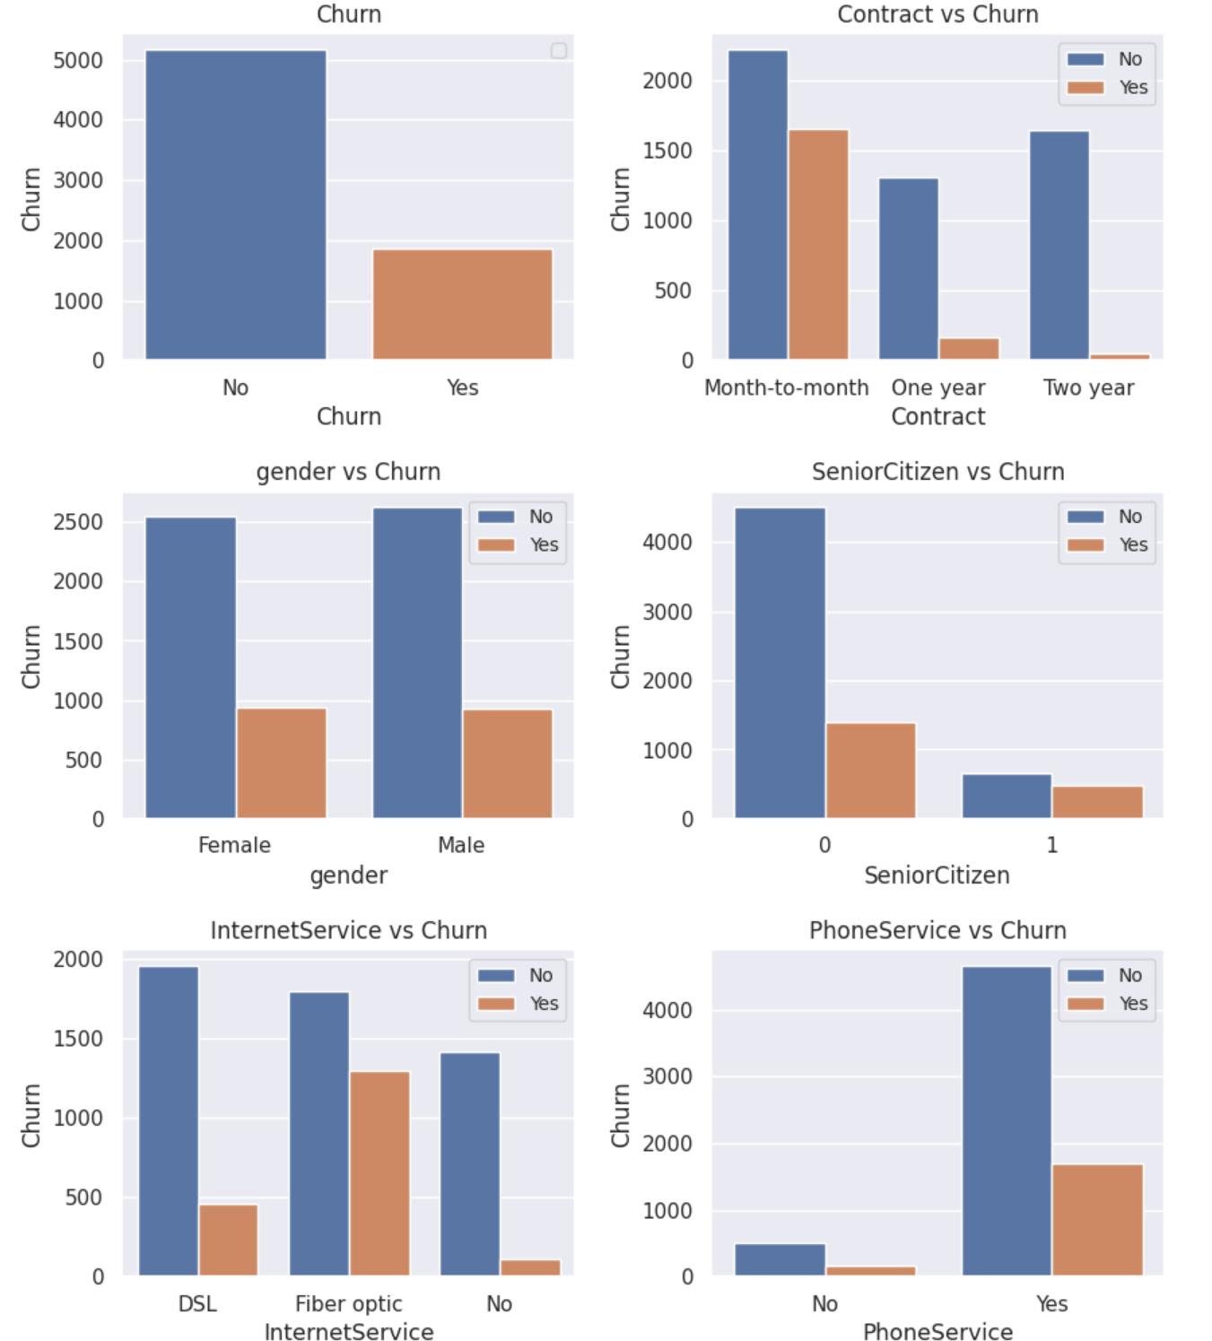
Visual Insights
Analysing the features against the target feature ‘Churn’ gives insights like,
Long term contract has fewer Churns compared to Month to month.
InternetService option plays a vital role in the churn rate.
Gender doesn't have much impact on the target.

Slide 6
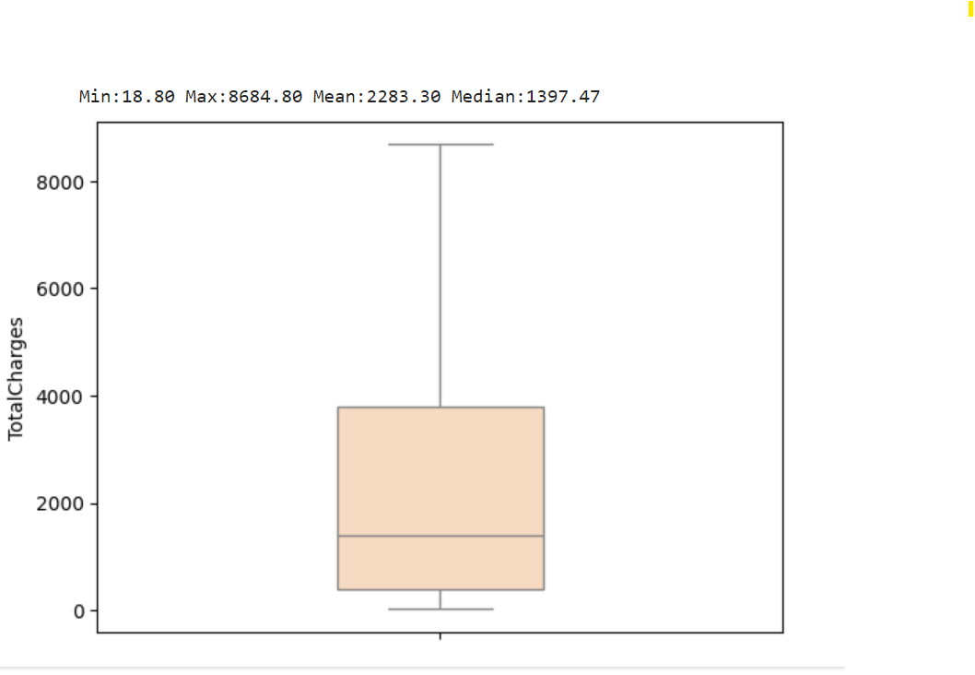
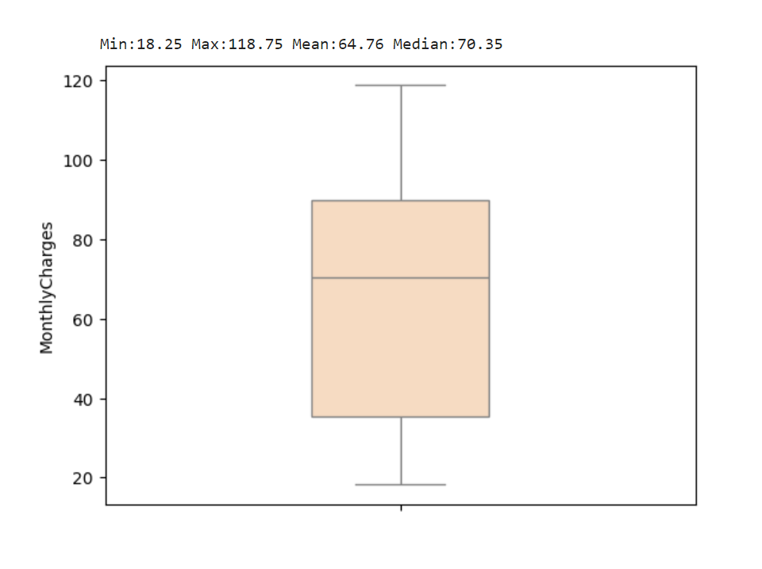
Visual Insights on ordinal features
Box plot for the ordinal features to identify the outliers if any and no significant outliers found for total charges and monthly charges.

Slide 7
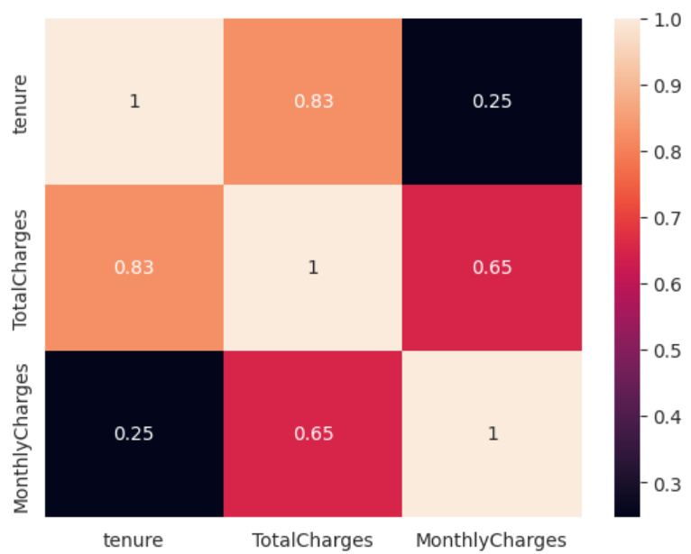
Visual Insights on ordinal features
Heatmap to find the correlation between ordinal features
Monthly Charges,
Total Charges and
tenure.
Tenure and total charges seem to have a significant correlation.

Slide 8
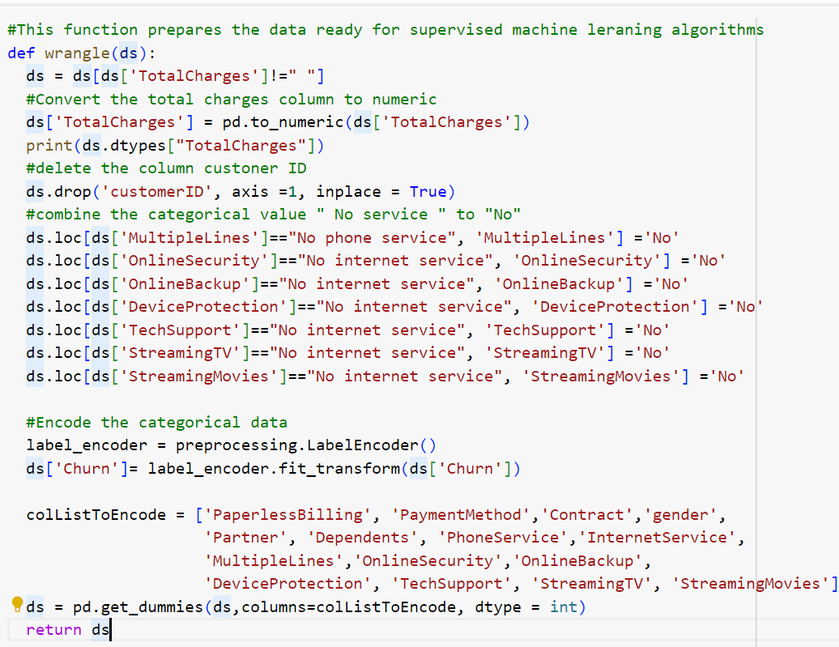
Data Preprocessing

Slide 9
Model Selection
Classifier algorithms are well suited for predicting the categotical variable ‘Churn’.
Following Machine learning algorithms for classification problems are evaluated,
Logistic Regression,
DecisionTree Classifier and
Random forest Regression and
Cross Validation to evaluate the models
GridSearchCV for hyper parameter tuning.

Slide 10
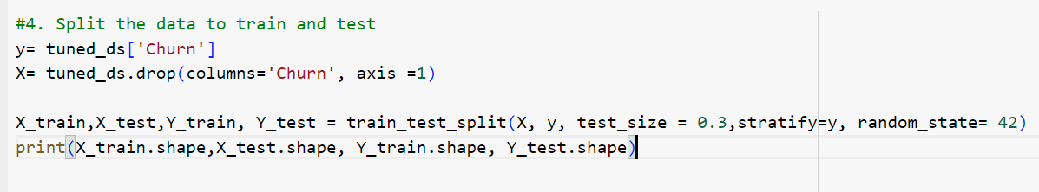
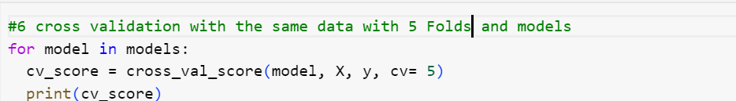
Training and Test data, 2 ways
Used Train test split from sklearn library to prepare training data and test data
2. Cross validation technique to train the models with K Folds(5 Folds)

Slide 11
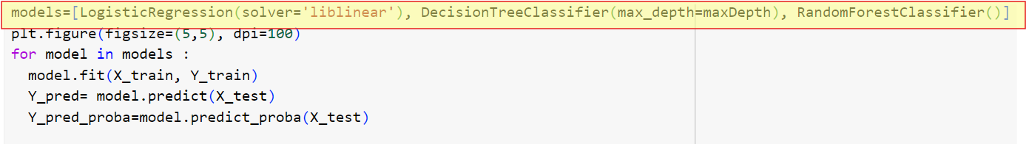
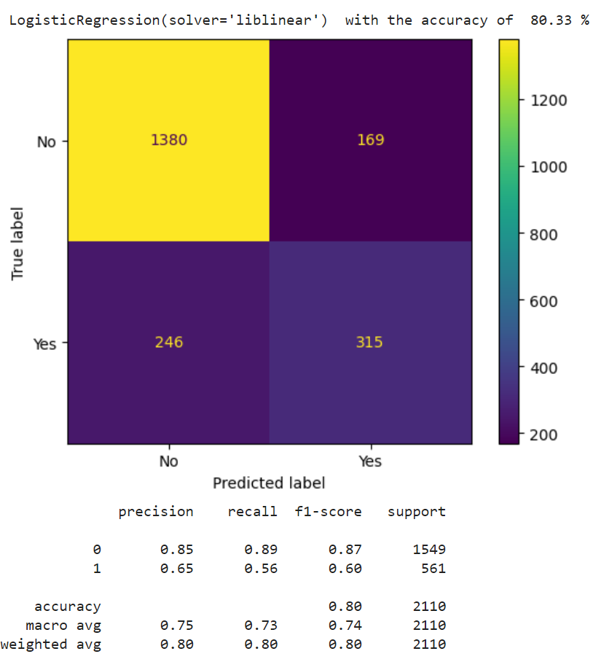
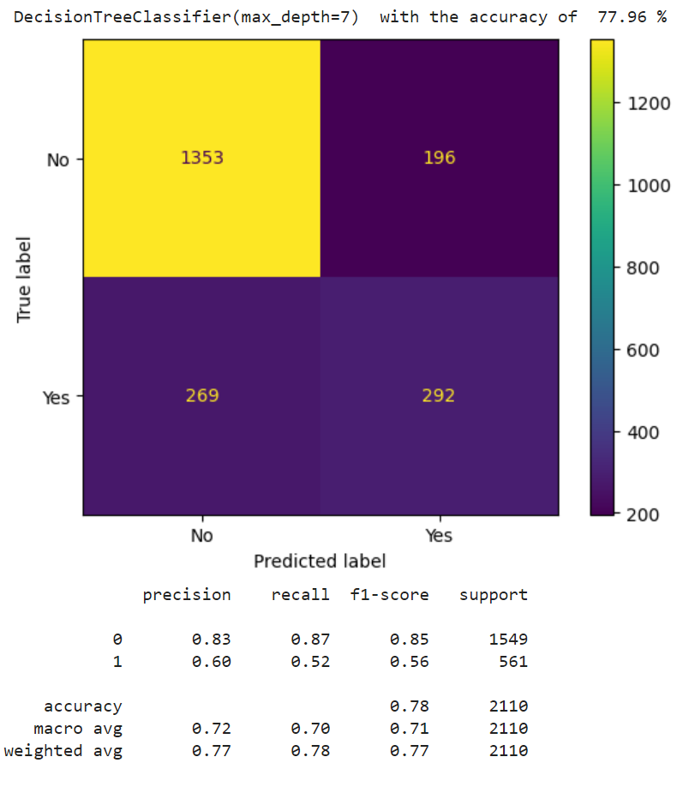
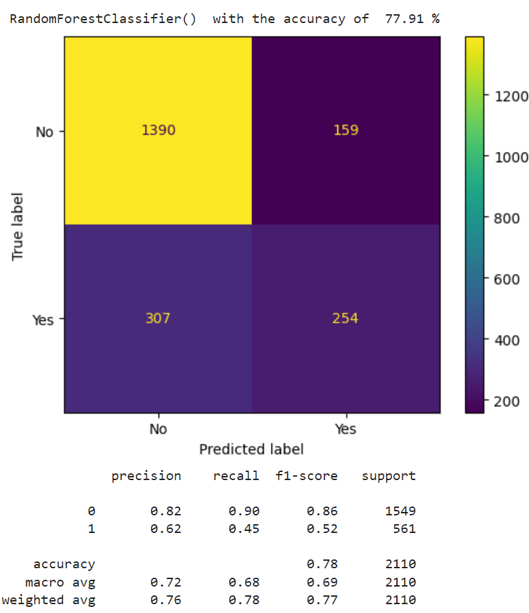
Training and testing the models

Slide 12
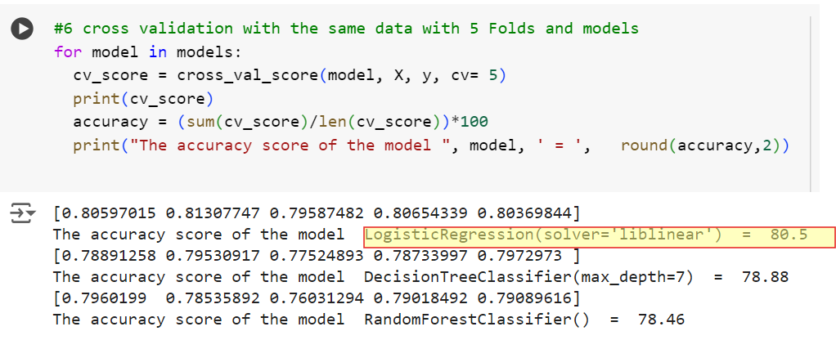
Cross Validation with 5 Fold

Slide 13
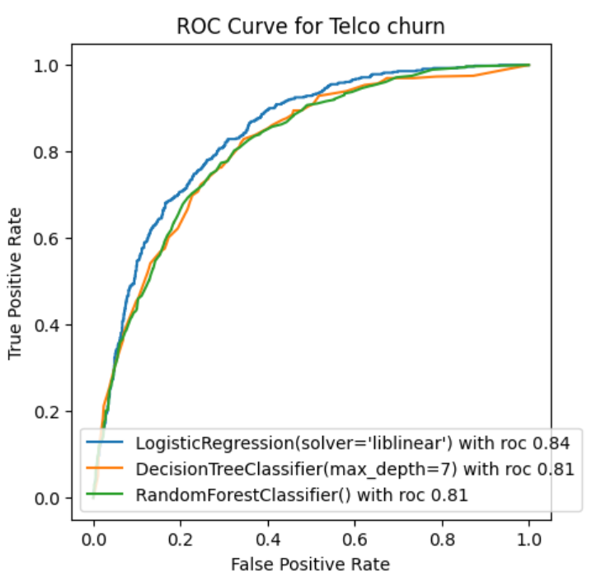
Model Selection
Metrics from the logistic regression ‘Accuracy’, ‘Recall’ and ‘AUC’ is slightly higher than the other models.
Logistic Regression is best suited machine learning algorithm for this problem

Slide 14
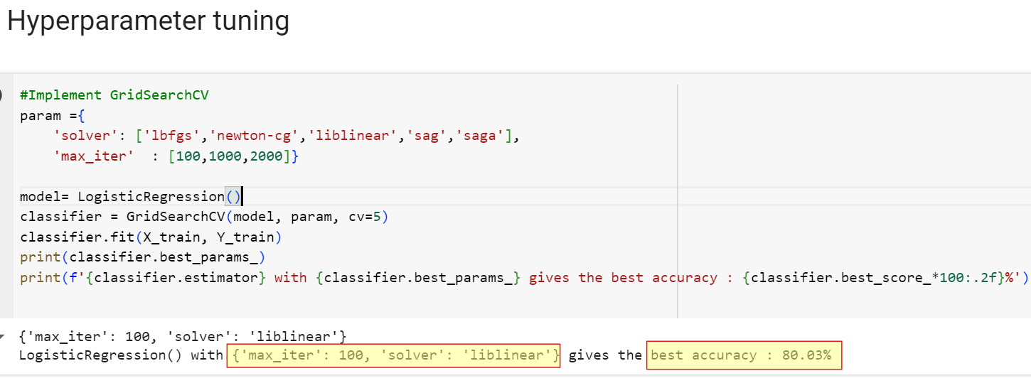
Hyperparameter Tuning
Parameters like solver and the max_iter are tuned using GridSearchCV to get the highest accuracy possible.

Slide 15
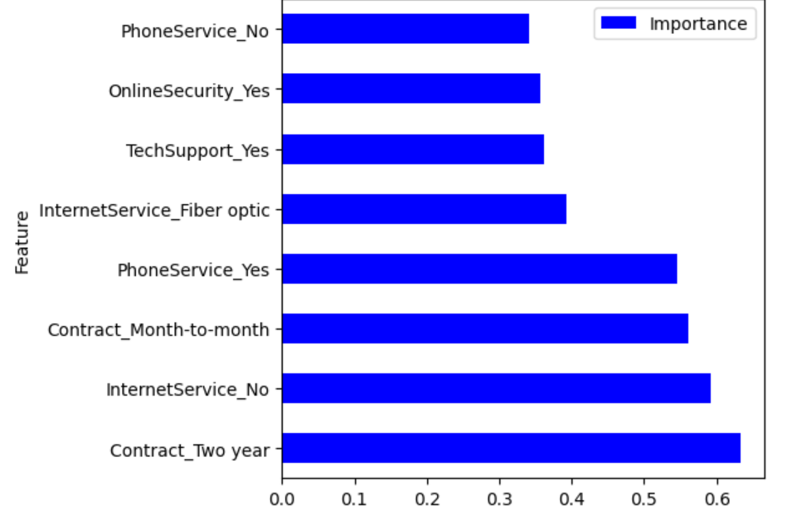
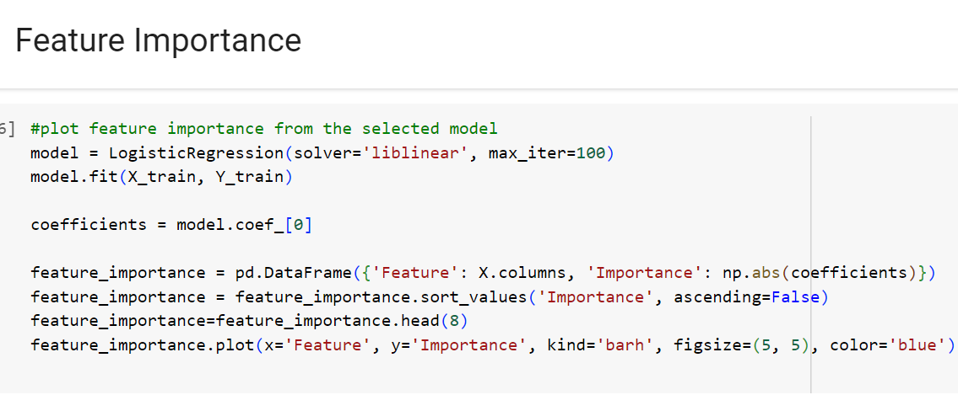
Feature Importance

Slide 16
Conclusion
Machine learning algorithm, Logistic regression is well suited for this problem among the other classifier algorithms with 80% accuracy.
Contract Type and Services play a significant role in churning of the customers.
Enrolling the customers on the verge of Churning , the other long lasting customers and the new customers to the following is suggested for business improvement.
Retention reward campaign,
Loyalty reward program and
Onboarding discounts.

Slide 17

Alamelu Ramanathan
alamurm@gmail.com

